Slide 1


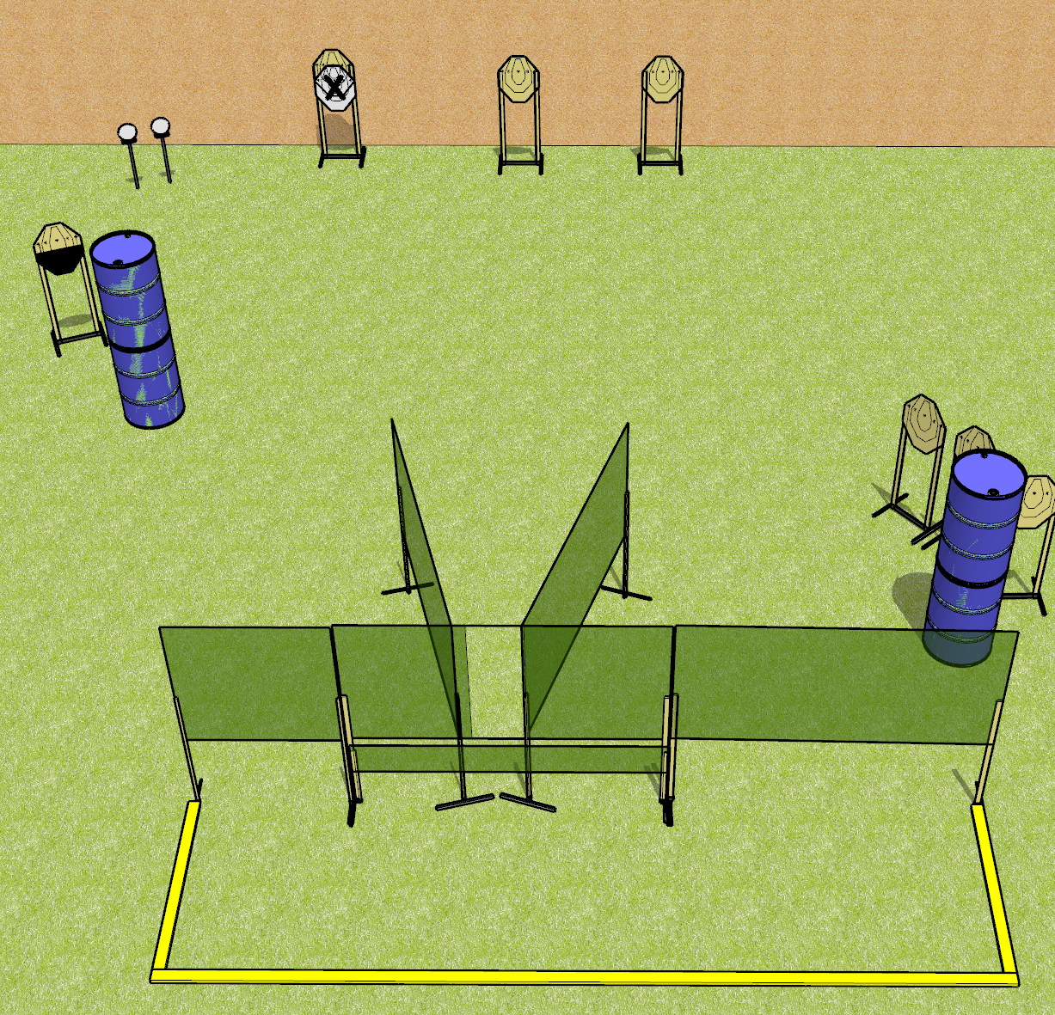
 | Dothan Gun Club – USPSA Match Down and Dirty Course Designer : Drew Coleman
Round Count 16 rounds 7 IPSC 2 plates
Equipment List 10 wall feet 2 medium fault lines 1 half IPSC

Slide 2
Down and Dirty
Written Stage Briefing
Down and Dirty is a 16 round, 80 point, Comstock course of fire. There are 7 ISPC targets and 2 plates. The best 2 hits on paper will score and steel must fall to score. The start signal is audible.
Handgun start position is anywhere completely outside the shooting area, wrists below belt. Handgun is loaded and holstered.
PCC start position is anywhere completely outside the shooting area, stock on belt. Loaded carbine is held with both hands, safety on.
On start signal, engage targets as they become available from within the shooting area.

